Slide 1
The Minnesota Golf Course
“A community's largest rain garden”
Presented by
Jack MacKenzie, CGCS - Executive Director
Minnesota Golf Course Superintendents Association
and
Chase Straw, Ph.D. - Postdoctoral Research Associate
Department of Horticultural Science
University of Minnesota

Slide 2
Yes, golf needs and uses water
Roughly 460 courses
Average of 7.8 billion gallons per year (as of 2015)
0.76% of all water consumed in the state
Golf injects $2.3 billion into the economy (2018 EIS)
25,000 employed annually
Golf is a big industry of small businesses; however,
fate could be tied to water restrictions

Slide 3
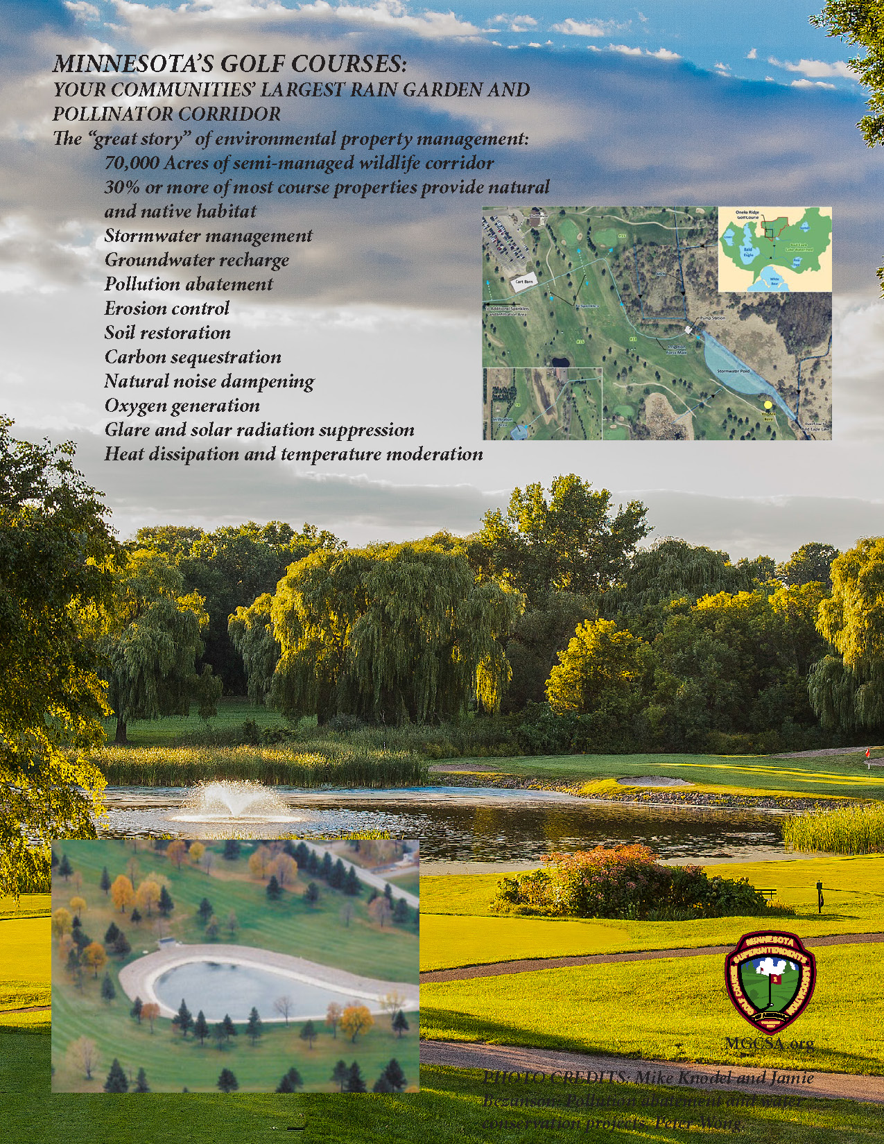
The community’s largest rain garden
70,000 acres of semi-managed green space
30% of most courses out of play and native
Stormwater management
Pollution abatement
Erosion control
Soil restoration
Carbon sequestration
Natural noise dampening
Oxygen generation
Glare and solar radiation suppression
Heat dissipation and temperature moderation
Wildlife sanctuary
Pollinator habitat
Notes:
Golf is a local and logical destination for water management, and so much more

Slide 4
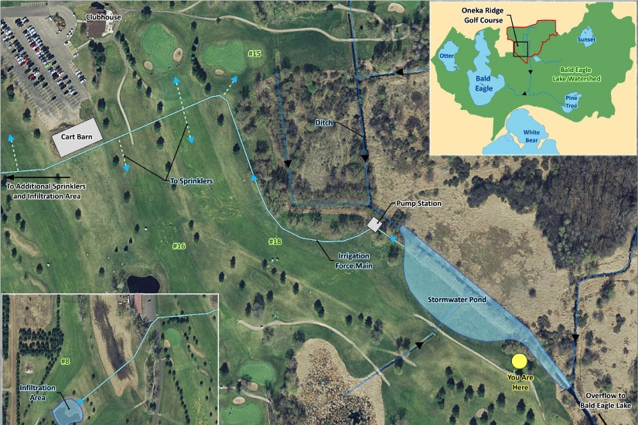
Oneka Ridge Golf Course
Pollution mitigation
Groundwater recharge
Storm water reuse
Groundwater reduction
Notes:
Golf is a ready and willing “good neighbor” when it comes to water management

Slide 5
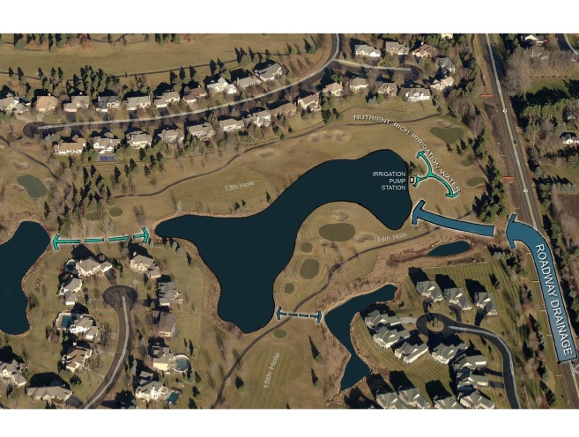
Prestwick Golf Club
Highway expansion project:
Storm water capture
Pollution mitigation
Groundwater reduction
Water reuse/irrigation
Up to 15 mg annually

Slide 6
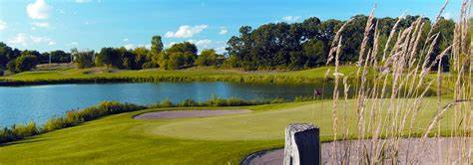
Eagle Valley Golf Club
Highway expansion project:
Storm water capture
Pollution mitigation
Groundwater reduction
Water reuse/irrigation

Slide 7
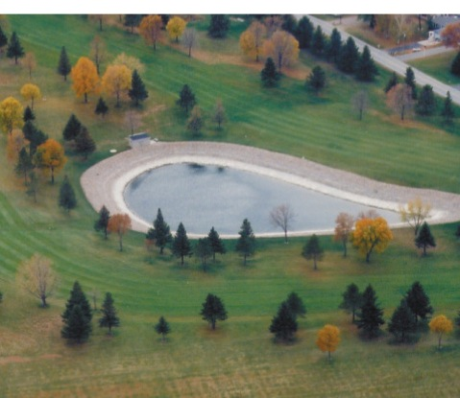
Oakdale Golf Club
Partnership with residents around Lake Allie to create a wastewater system (18,300 gpd) and supplement irrigation water
Groundwater use reduction

Slide 8
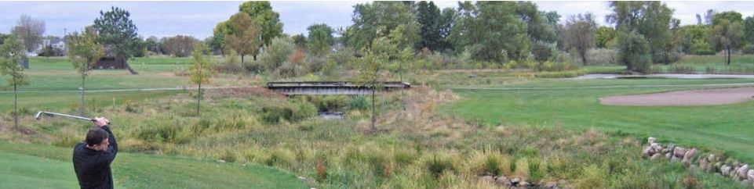
Oak Glen Golf Course
Buffer and stream restoration
Environment enhancement
Trout habitat enrichment
Pollution mitigation
Erosion control

Slide 9
Gray water use at other golf destinations:
Pollution mitigation , groundwater infiltration and supplemental irrigation:
Keller Golf Club
Forest Hills Golf Club
The Meadows at Mystic Lake
Izaty’s Golf and Resort
The Pines at Grandview Lodge – discontinued due to salt build up
Notes:
Golf is a willing partner taking on these disruptive projects in an effort to support environmental stewardship

Slide 10
With the support of the Board of Soil and Water Resources, Department of Natural Resources, Department of Agriculture, and University of Minnesota, golf has developed:
BMP’s for nitrogen and phosphorous fertilizer use on MN turfgrasses
BMP’s for pesticides used in turfgrass management
MN golf reference handbook of management practices
BMP’s for golf course water-use efficiency/conservation plans
All available at MGCSA.org
Notes:
Golf has upped its “environmental stewardship game” in recent year

Slide 11

Investment in UMN Research

Slide 12
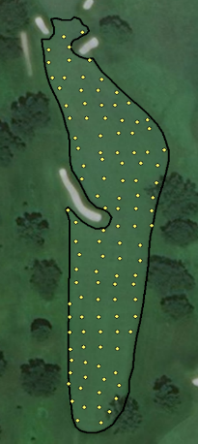
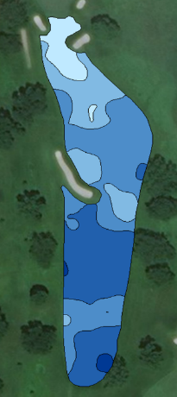

Precision Turfgrass Management
Technologies for precision irrigation:

Slide 13
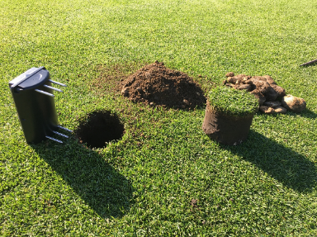
Precision Turfgrass Management
Technologies for precision irrigation:
Soil moisture readings every 5 minutes

Slide 14
Precision Turfgrass Management
Limitations and barriers to adoption of technologies for precision turfgrass management (including precision irrigation):
Cost
Time
Training/experience
Lack of simple and consistent protocols
Lack of decision support systems
Criteria to assess agronomic, environmental, cost benefit
Carrow et al. (2010); Straw et al. (2019)

Slide 15



Precision Turfgrass Management

Slide 16
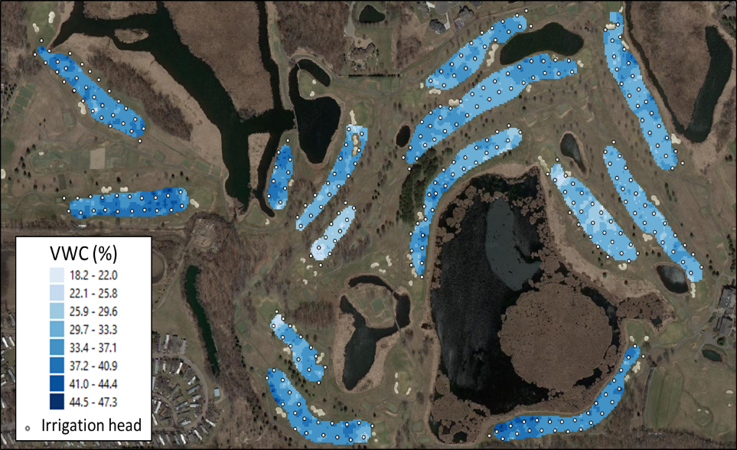

Slide 17
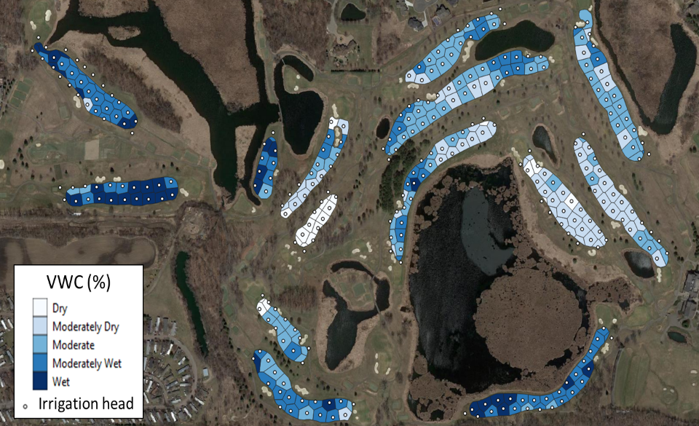

Slide 18
Golf has concerns about long term permit suspensions
Minnesota Statute 103G.261 water use priorities
Currently a category six priority, nonessential use
  Times of drought
  Total suspension, no irrigation allowed from public resources
  Impacts surface water users first
    Ground water/surface water influence?

Slide 19
How can golf have assurance of limited water during times of a business crippling drought crises?
Perhaps a category seven priority: businesses, under the guidance of the Commissioner, who have demonstrated water efficiency and conservation practices will be allowed limited access to irrigation water as determined by the Agency during times of water crises

